Slide 1
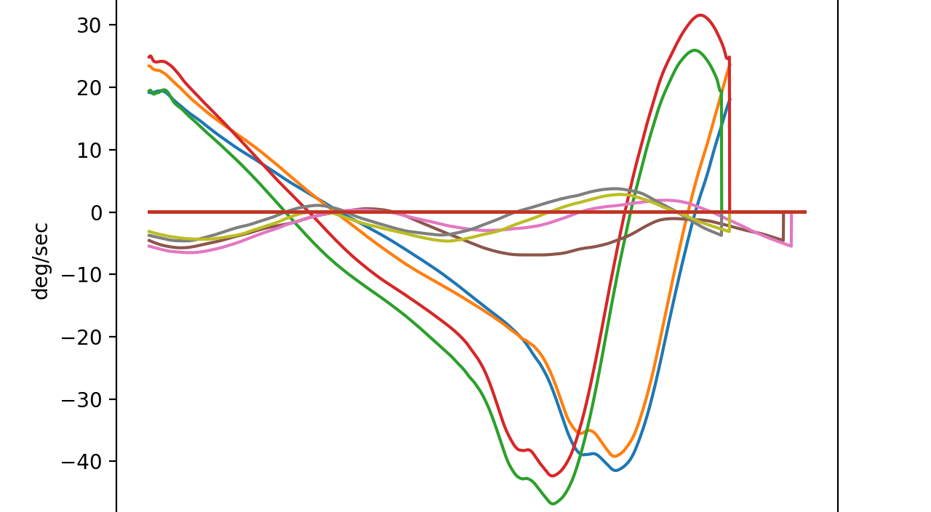
Poll and Cannon Motion
Cannon Angle (degs) and Poll pitch angle (degs)
Impact
mid-stance
Angle deg.
Roll over
Time - secs

Slide 2
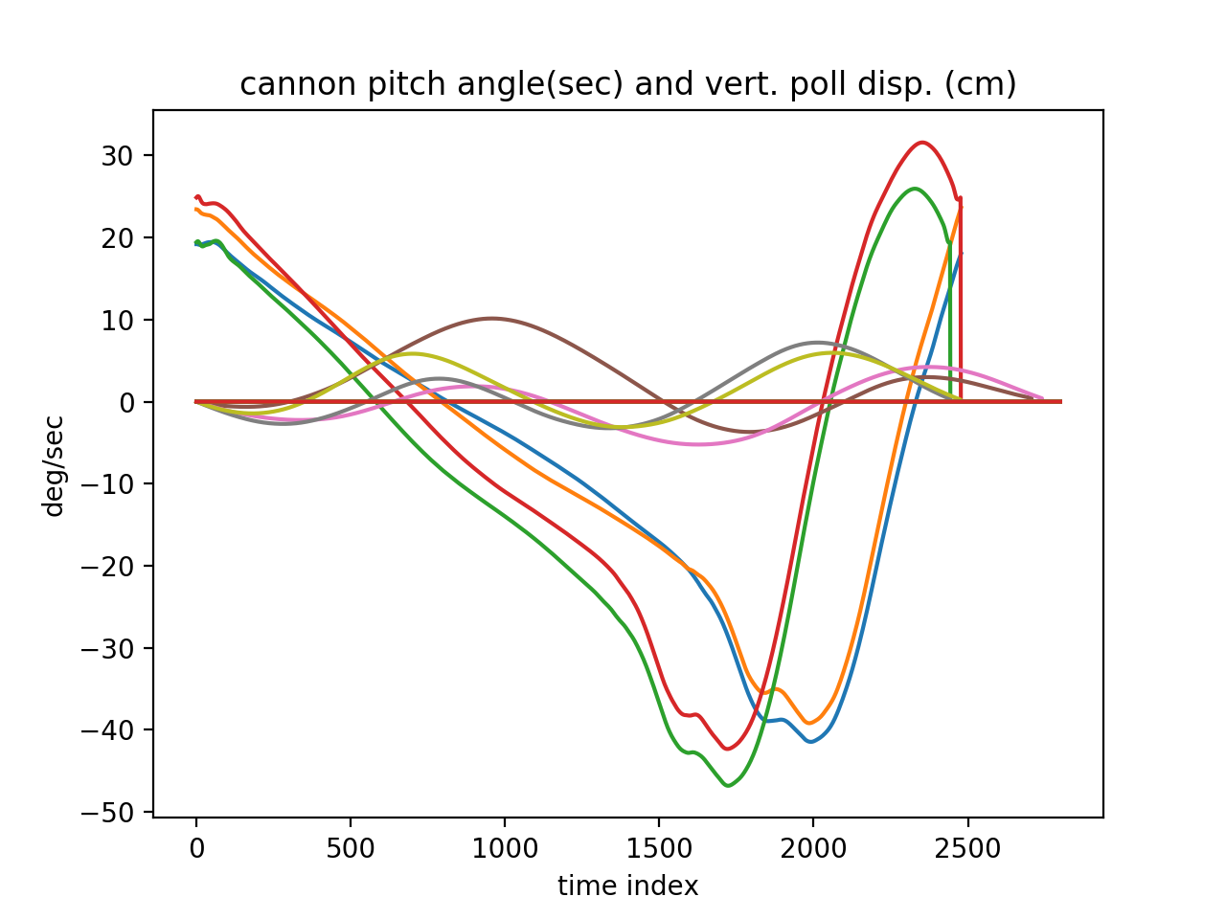
Poll and Cannon Motion
Cannon Angle (degs) and Poll vertical displacement (cm)
Impact
mid-stance
Angle deg.
And
Vertical . Displacement (cm)
swing
Roll over
Time - secs

